Slide 1
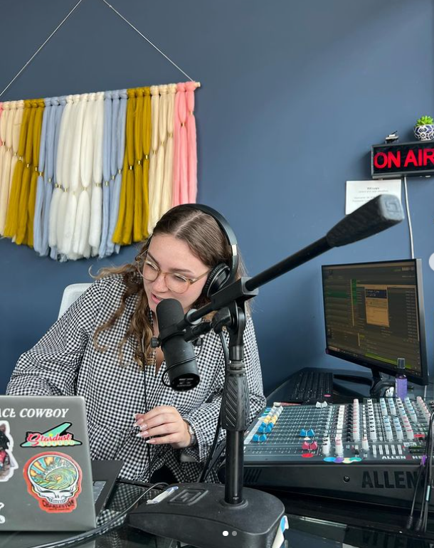

My Portfolio
HOLLIS COLLMAN
collaborative, colorful communicator
www.hcollman.com

Slide 2
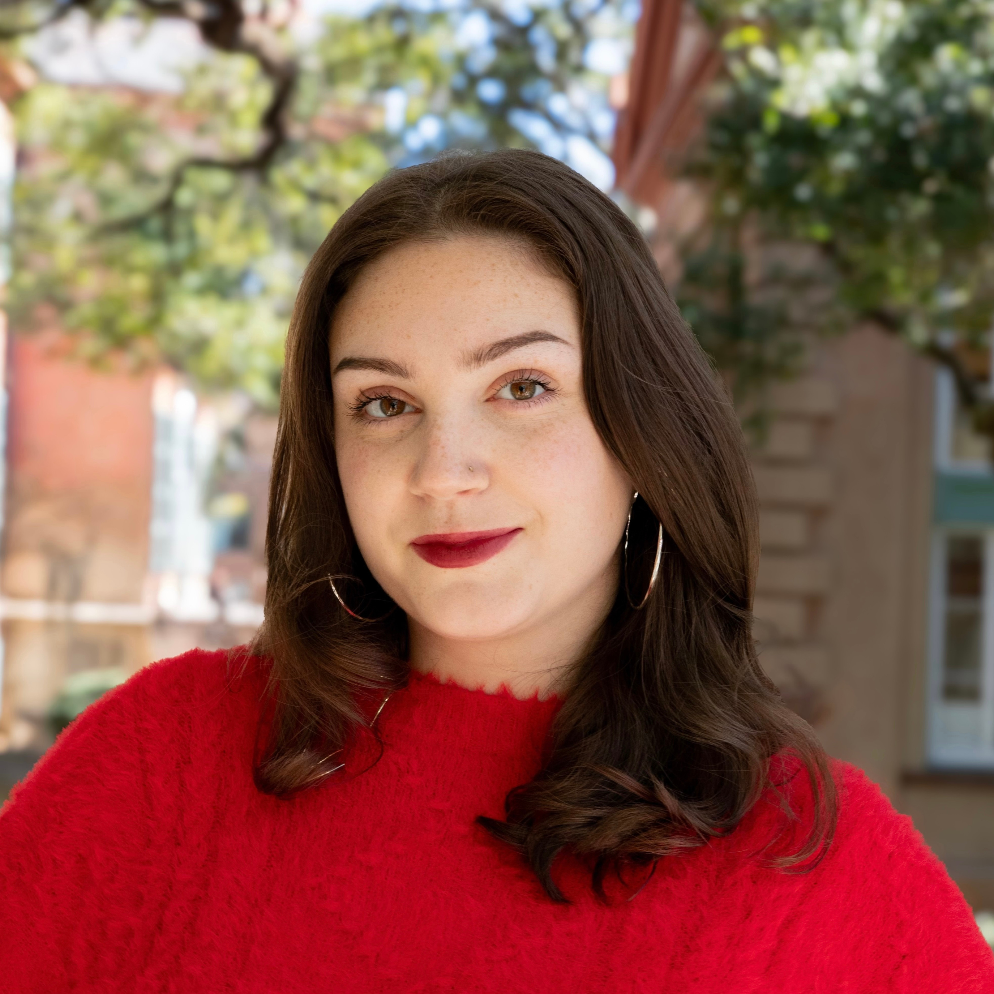

About Me
HI THERE!
My name is Hollis Collman. I am an inspired and detail-oriented lifelong learner, passionate about community and culture with an insatiable love for creating connections and making things that matter. I’m crafty, adventurous, naturally curious, and always looking for a challenge.
My interests lie in brand development, creative storytelling, traditional PR, and vibe curation. I have an eye for aesthetics and love combining my passion for perfection into my work.
www.hcollman.com

Slide 3

PR & MARKETING INTERN
One Region Strategy
Jan 2025 - May 2025
  Redesign One Region’s website: update content, mission statement, and key initiatives with updated language and visuals.
  Manage LinkedIn content, craft posts to highlight impact, success stories, and key initiatives of O.R. and Lead Agents. Increased following and engagement by 34% in 6 weeks.
  Research regional initiatives and industry trends to support marketing and PR efforts.
WORK EXPERIENCE
AGENCY ASSOCIATE,
CHARLESTON WINE + FOOD
College of Charleston
August 2024 - May 2025
View my LinkedIn!
  Conduct primary and secondary research to inform communication planning efforts.
  Outline client needs/goals and develop detailed timelines to satisfy them.
  Responsible for designing and producing external messaging: community outreach, partnerships, community events participation, CSR efforts and brand visibility.
PR & MARKETING INTERN
OHM Radio 96.3FM
Summer 2024
  Produced and hosted weekly show, Happy Hour with Holly, driving audience interaction.
  Generated press releases for local events and MailChimp campaigns for weekly show archives, developing newsletters for 800+ subscribers.
  Drafted new press kit to attract potential underwriters.
  Managed email, news, and social media contact list.
www.hcollman.com

Slide 4
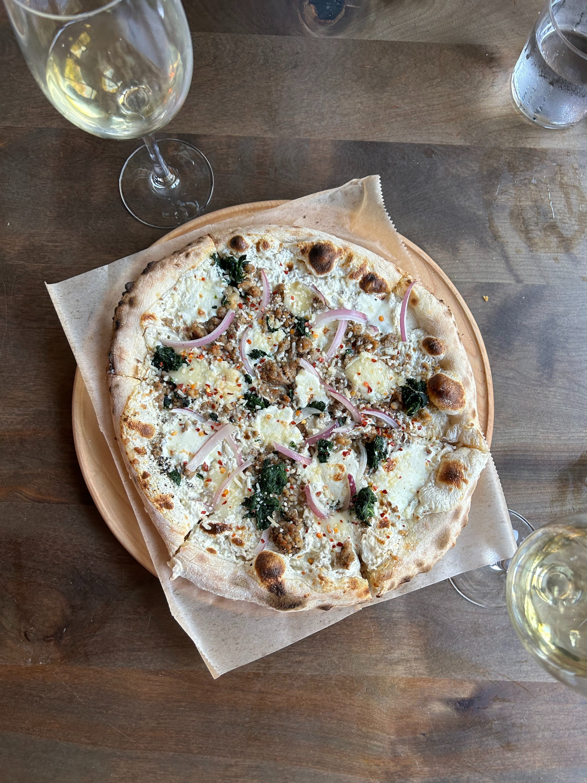
Why Everyone Should Work in the Service Industry
BLOG POST:
Almost 6 years and counting of working in one of the most exhausting yet rewarding industries in the world. The service industry has many levels and faces, but the core is the same wherever you go. The lessons one learns when working in any restaurant or cafe are incredibly valuable and universally applicable in any field, especially ones where people are your main priority.
Dealing with guests, coworkers, and corporate in the same place allows you to fine-tune your people skills to each situation to keep everyone happy. There are many other skills you learn both voluntarily and involuntarily, out on the floor and back in the kitchen.
If you can handle a Sunday brunch rush with no OJ or pancake syrup, an agitated grill cook that only speaks Spanish, a hostess who can't say no, and a bartender that should have gone to sleep a little earlier the night before, you can handle anything. And I'm here to tell you, everyone should experience this at least one time.
Read the full article HERE

Slide 5

HAPPY HOUR WITH HOLLY
During my Summer 2024 internship with local Charleston nonprofit OHM Radio 96.3FM, I had the chance to express my own interests through an hour-long LIVE radio show every week which I named "Happy Hour with Holly." I chose a local Charleston restaurant, combed through the menu to pick out a drink, appetizer, and entree, then matched three songs to each while discussing both the food and the music.
Enjoying some of the cuisine Charleston has to offer (for research, obviously) AND getting to share my music taste on the air?
Sign me up!
Listen to my episode featuring The Watch Rooftop here

Slide 6
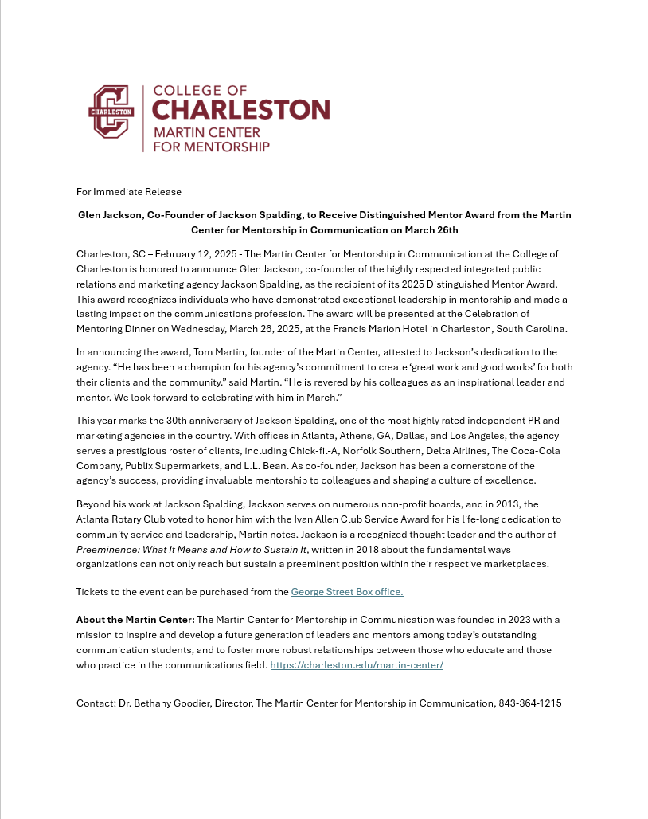
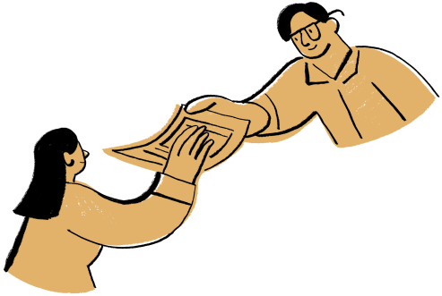
PRESS
RELEASE
Written for The Martin Center for Mentorship in Communication
Glen Jackson, Founder of Jackson Spalding, to Recieve Distinguished Mentor Award from the Martin Center for Mentorship in Communication

Slide 7
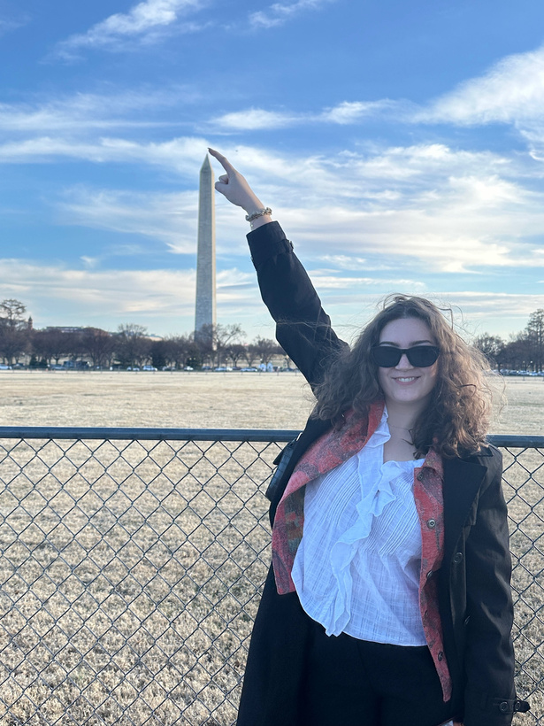
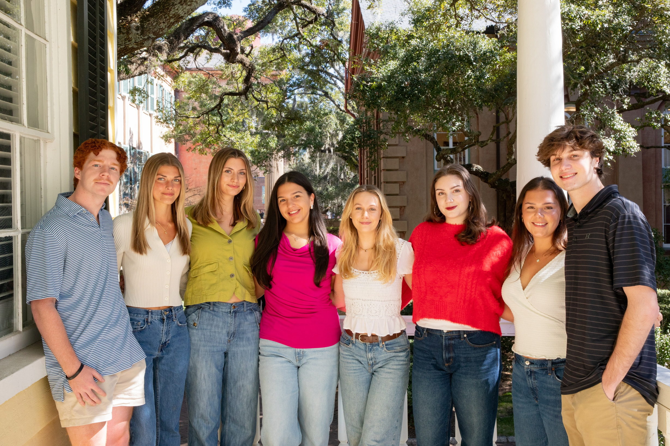
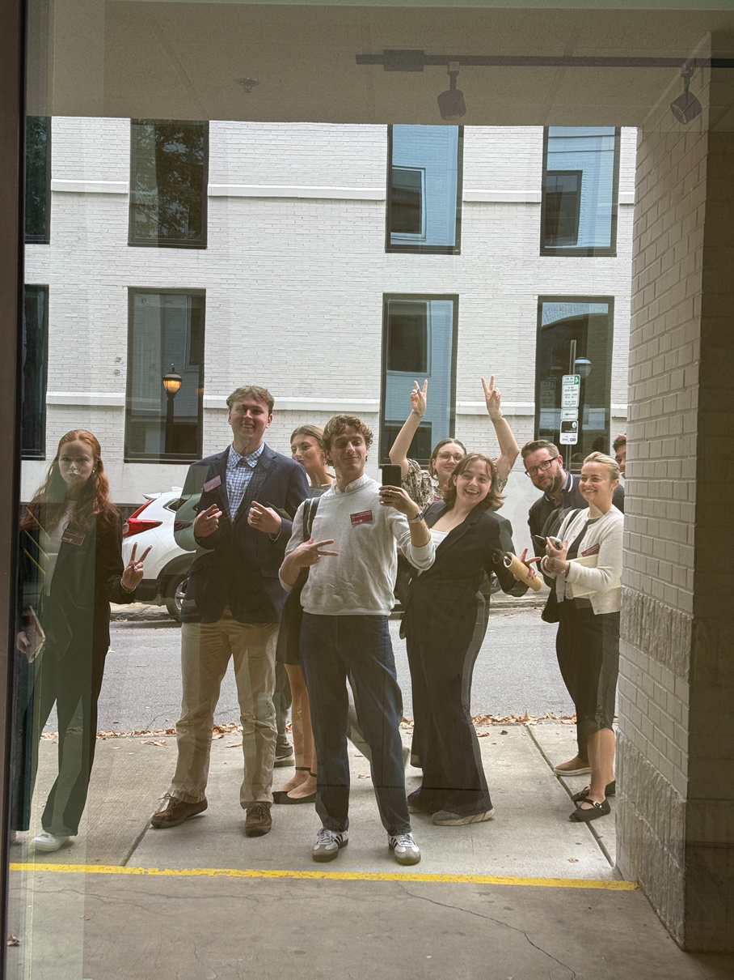




LET’S WORK TOGETHER!
Phone Number
Email Address
704-512-9600
holliscollman1@gmail.com
LinkedIn
Personal Website
Hollis Collman
www.hcollman.com

